Slide 1
World of Technology
Unit 0 – Section 1 – Day 1

Slide 2
The bid idea
The 21st century skills of collaboration and problem solving are essential for engineering solutions of the future.

Slide 3
The bid idea
Design a self-propelled vehicle that will transport a passenger safely from point A to Point B.
Restrictions:
You may only use the provided materials
You have one class period to complete the activity

Slide 4
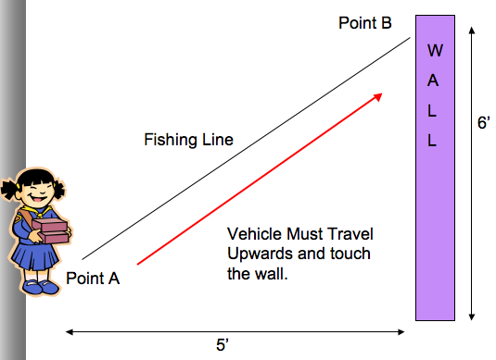
The course

Slide 5
materials
You must construct a vehicle to travel from point A to point B under its own power using only the following materials:
12” of Masking tape
1 Popsicle Stick
1 Balloon
2 paper clips
2 rubber bands
1 Clothespin for a passenger

Slide 6
Title and content layout with chart

Slide 7
Two content layout with table
First bullet point here
Second bullet point here
Third bullet point here
Class | Group 1 | Group 2
Class 1 | 82 | 95
Class 2 | 76 | 88
Class 3 | 84 | 90

Slide 8
Two content layout with SmartArt
First bullet point here
Second bullet point here
Third bullet point here
Step 1
Step 2
Task Description
Task Description
Task Description
Step 3

Slide 9
Add a Slide Title - 1

Slide 10
Add a Slide Title - 2

Slide 11
Add a Slide Title - 3

Slide 12
Add a Slide Title - 4

Slide 13
Add a Slide Title - 5

